Slide 1
January 2021
Developing Pedagogy That Fosters Anti-Racism
January 14, 2021 | 9am-1pm
*please mute your microphone upon entry*

Slide 2


Focus on Teaching & Learning January 2021
Welcome to FOTL!
Remain on Mute when you're not speaking.
All sessions are being recorded.
NOTE: All session recordings are started automatically. As a result, recordings may start with a few minutes of chatter or presenter preparation. If you are watching this on demand, feel free to skip ahead to the presentations.

Slide 3
Land Acknowledgement
The Loyola community occupies the ancestral homelands of the people of the Council of Three Fires, an alliance which formed based on the shared language, similar culture, and common historical background of its three historical members: the Odawa, Potawatomi, and Ojibwe nations.
The land that Loyola occupies, which includes the shore and waters of Lake Michigan, was also a site of trade, travel, gathering and healing for more than a dozen other Native tribes, including the Menominee, Michigamea, Miami, Kickapoo, Peoria and Ho-Chunk nations. The history of the city of Chicago is intertwined with histories of native peoples. The name Chicago is adopted from the Algonquin language, and the Chicagoland area is still home to the largest number of Native Americans in the Midwest, over 65,000. The history of the lands Loyola occupies, and the history of Native Americans in Chicago and Illinois, is a history of displacement, conquest, and dehumanization.
We at Loyola, in step with our Jesuit Catholic tradition, must commit to acknowledging this violent history by incorporating Native American texts and perspectives into our classes and working to keep this shared history alive in our study, conversation, and professional development.

Slide 4
FOTL Planning Committee
Faculty Center for Ignatian Pedagogy
Bridget Colacchio Wesley, Jessica Mansbach, Jack Nuelle
Center for Experiential Learning
Patrick Green
Center for Science and Math Education
Timothy Stoelinga
Information Technology Services
Hannah Lee Otto
Office of Online Learning
Briana Allen
Office of Institutional Effectiveness
Stacy Wenzel
Parkinson School of
Health Sciences and Public Health
Justin Harbison
Student Academic Services
Betsi Burns
University Libraries
Susan Wardzala

Slide 5
Focus on Teaching & Learning January 2021
Opening Session Agenda
Opening remarks
Welcome from Amy Nelson Christensen
Student Panel: Experiences with and Reflections on Anti-Racist Pedagogy

Slide 6
January 2021
Developing Pedagogy That Fosters Anti-Racism

Slide 7
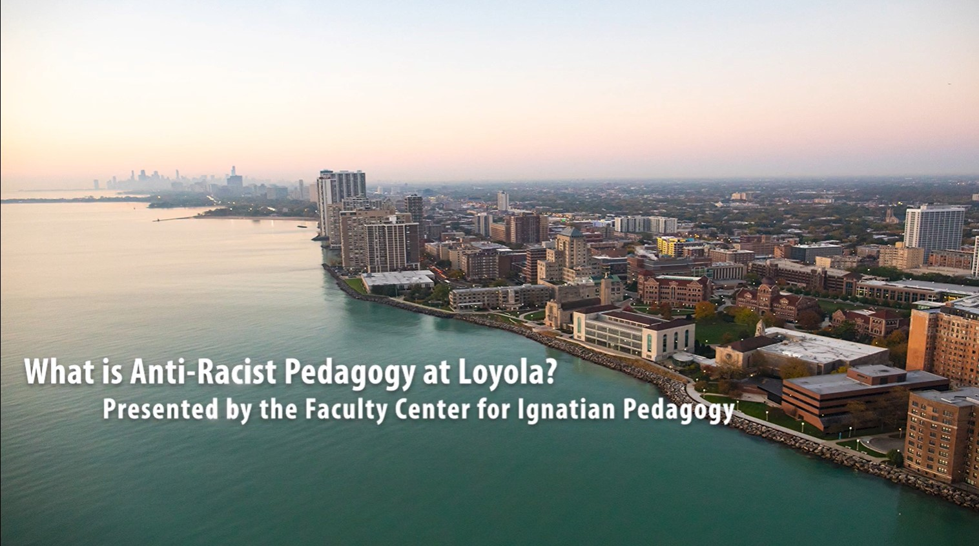
Focus on Teaching & Learning January 2021
VIDEO: What is anti-racist pedagogy at Loyola?

Slide 8
Anti-racist pedagogy at Loyola
Let's work together on this difficult but necessary project to shift our Loyola culture to include more transformative vision, equity, inclusion and justice.

Slide 9
Today's Schedule
Concurrent Sessions Block 1 10:45-11:45am
  Small Steps to Becoming an Anti-Racist Educator
  Decentering Whiteness in the Classroom
  Facilitating Discussion
Concurrent Sessions Block 2 12:00-1:00pm
  Outcomes and Assessments
  Intellectual Humility
  Responsiveness and Reflexivity in Everyday Pedagogy
Post-FOTL Working Group TOMORROW 10am

Slide 10
Post-FOTL Working Group
Join us!
When: Tomorrow, January 15, 2021, 10am-11am
What: Conversation about how to realistically and effectively implement anti-racist policies and practices within your academic department or administrative unit

Slide 11
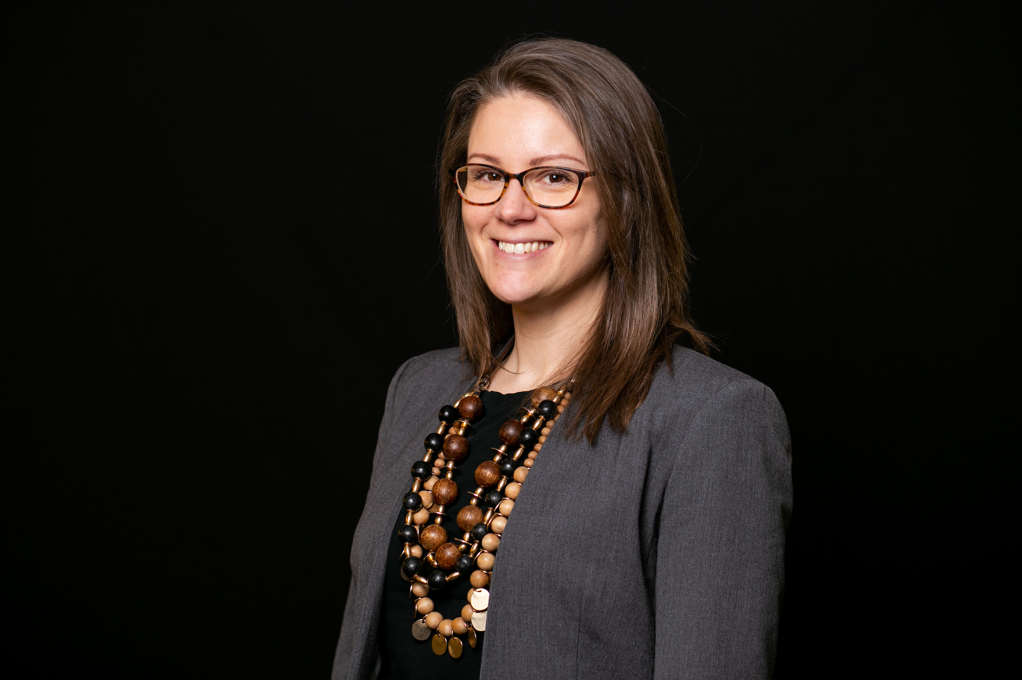
Welcome from Amy Nelson Christensen, PhD
Clinical Assistant Professor, School of Education
Chair, Anti-Racism Initiative
Loyola University Chicago
Notes:
Grzywacz pronounced: "Greevats"

Slide 12
THANK YOU to our
Student
Panelists
Clay Connor Ellmore
Katharine Flores
Moriah Johnson
Jacque Stefanic
Brandon Thomas
Anastasia Tull
Taylor Thomas

Slide 13
Student Panel
"Our Experiences with and Reflections on
Anti-Racist Pedagogy"

Slide 14
Experiences with and Reflections on
Anti-Racist Pedagogy
Engaging in self-education and anti-racist work

Slide 15
Experiences with and Reflections on
Anti-Racist Pedagogy
Using diverse scholarship and course design

Slide 16
Experiences with and Reflections on
Anti-Racist Pedagogy
Setting a constructive tone for discussion

Slide 17
Experiences with and Reflections on
Anti-Racist Pedagogy
Validating experiences

Slide 18
Experiences with and Reflections on
Anti-Racist Pedagogy
Summary: taking the next step
Do individual self-work and self-examination
Examine your syllabus and classroom policies
Find resources, participate in trainings, workshops and discussions
Affirm racial and ethnic differences
Speak up for students

Slide 19
FOTL Schedule
Access today's schedule on the FOTL webpage:
Use the link (in the chat) or go to
www.luc.edu/fotl and click "schedule"
If you have any questions, please email FCIP's Jack Nuelle at jnuelle@luc.edu

